Slide 1

SMART HOME

Slide 2
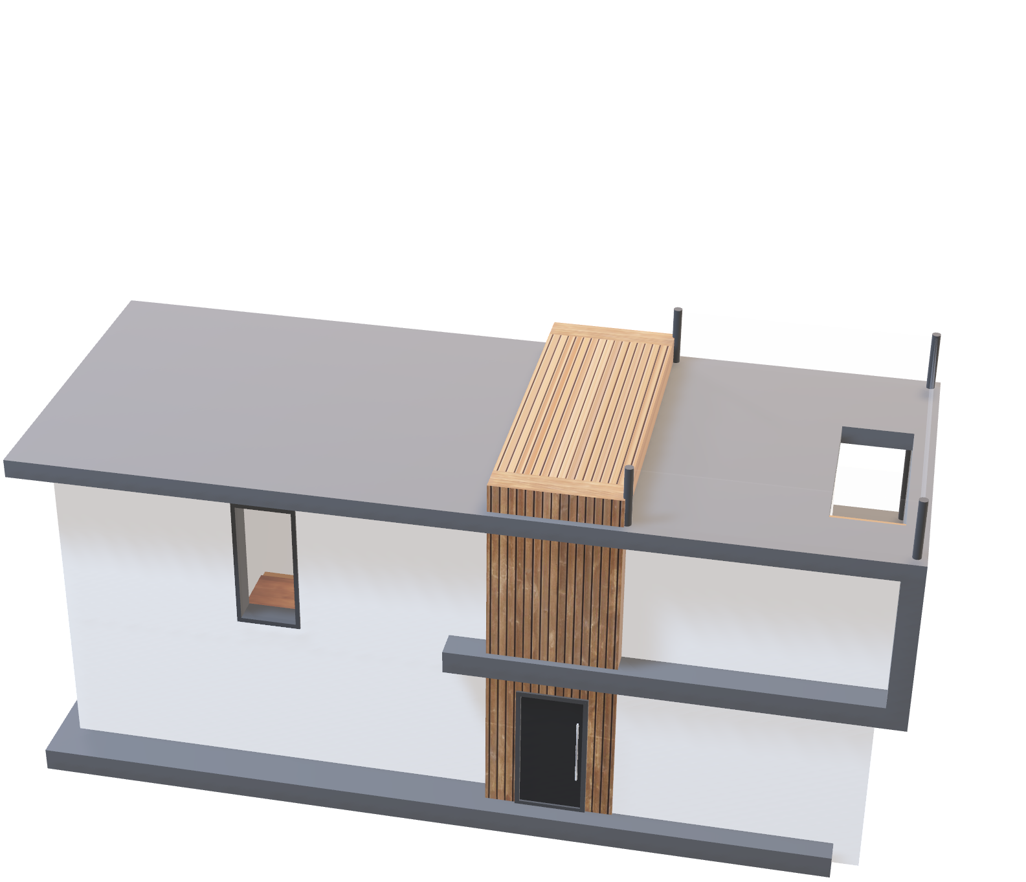
SMART HOME

Slide 3
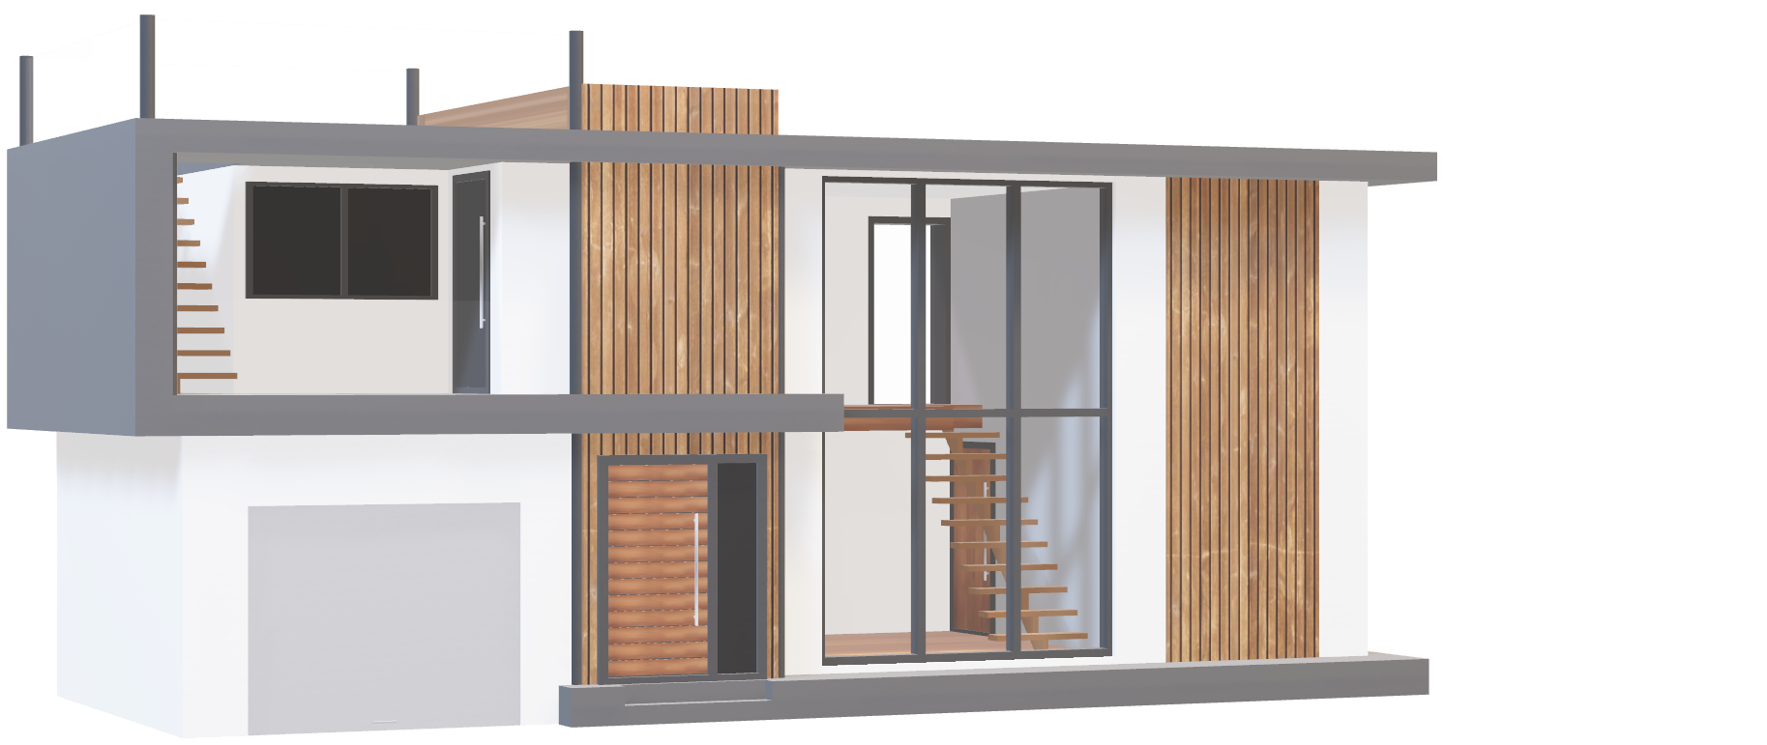
SMART HOME

Slide 4
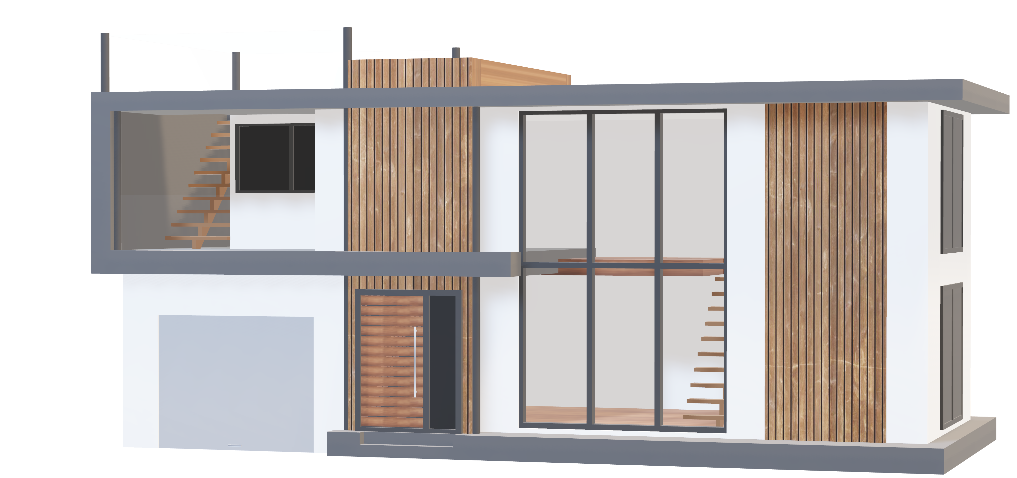
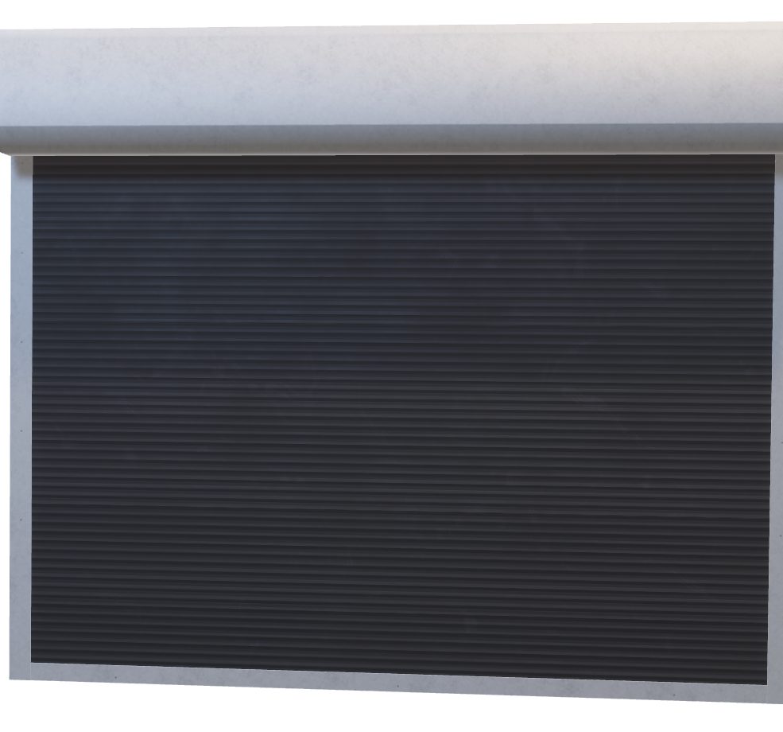
SMART HOME
Front Door Pin lock
In many contexts, keypad PIN locks are essential for maintaining security and controlling access. They provide an easy-to-use, configurable method of limiting access to those who are authorized.

Slide 5
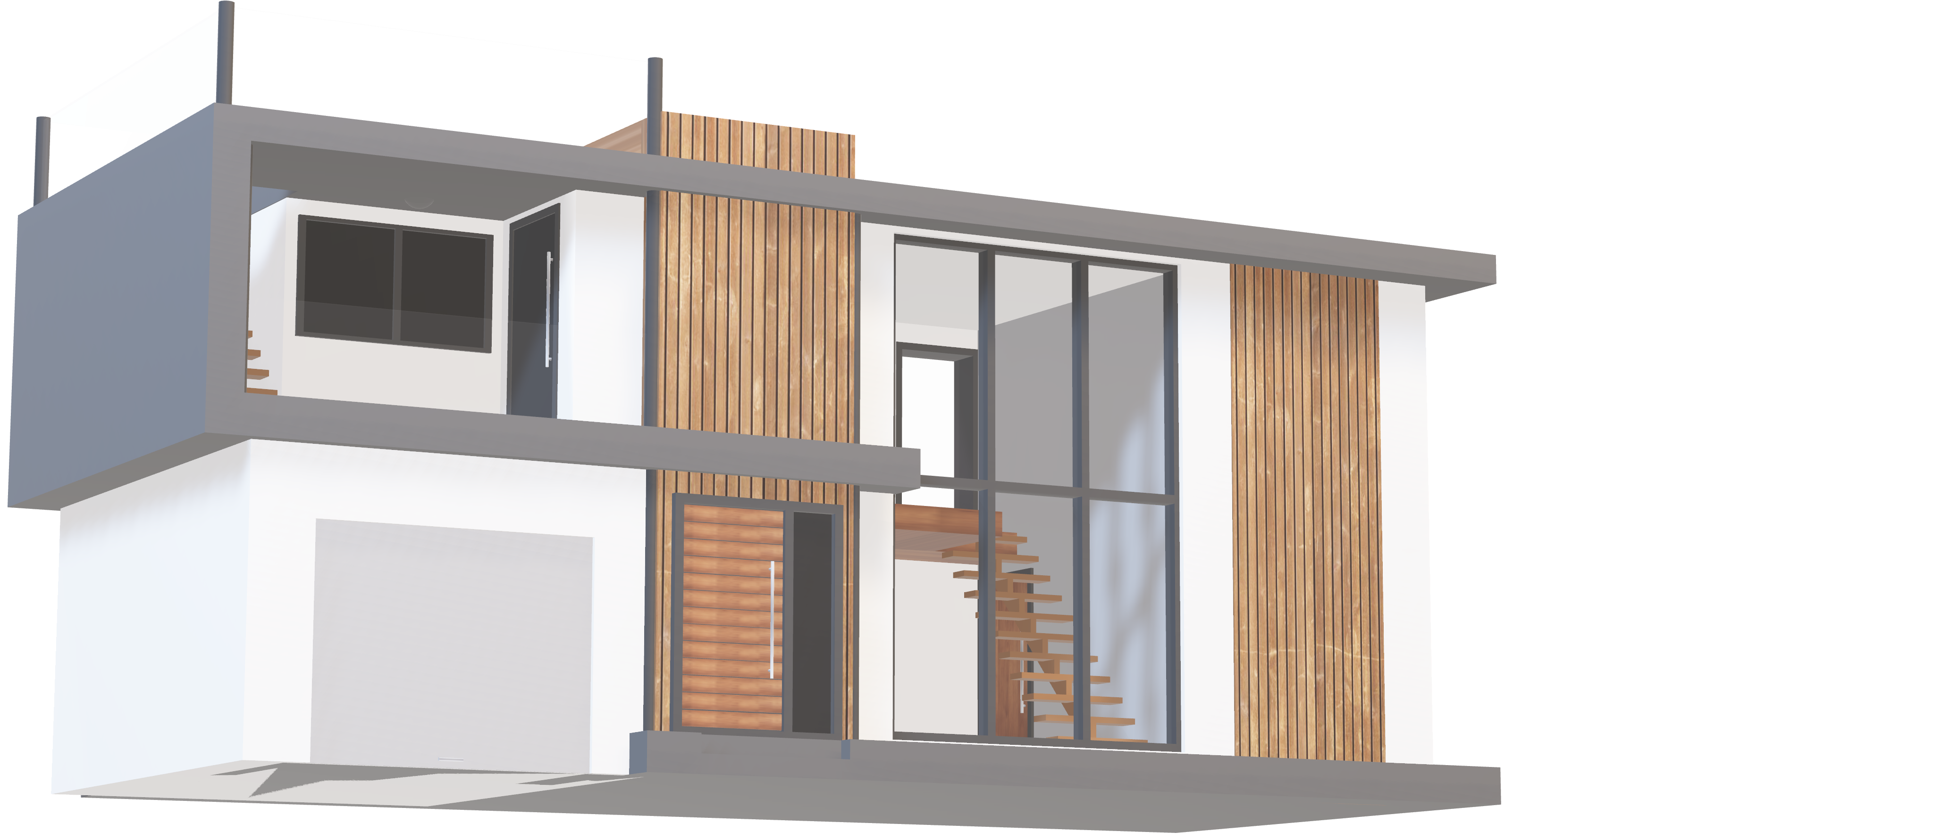
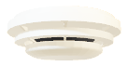
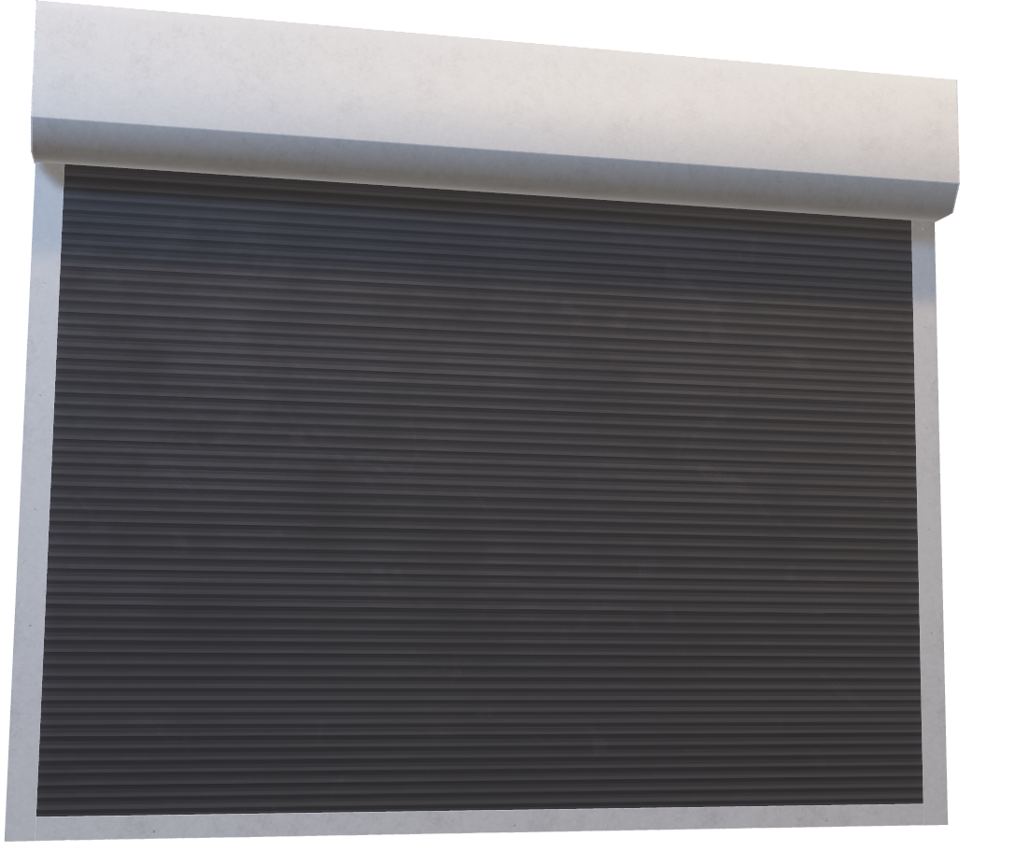
SMART HOME
Smart garage door
Modern home convenience and security depend greatly on garage doors that are equipped with infrared (IR) remote controls. By enabling homeowners to remotely open and close their garage doors, these systems improve accessibility and safety.

Slide 6
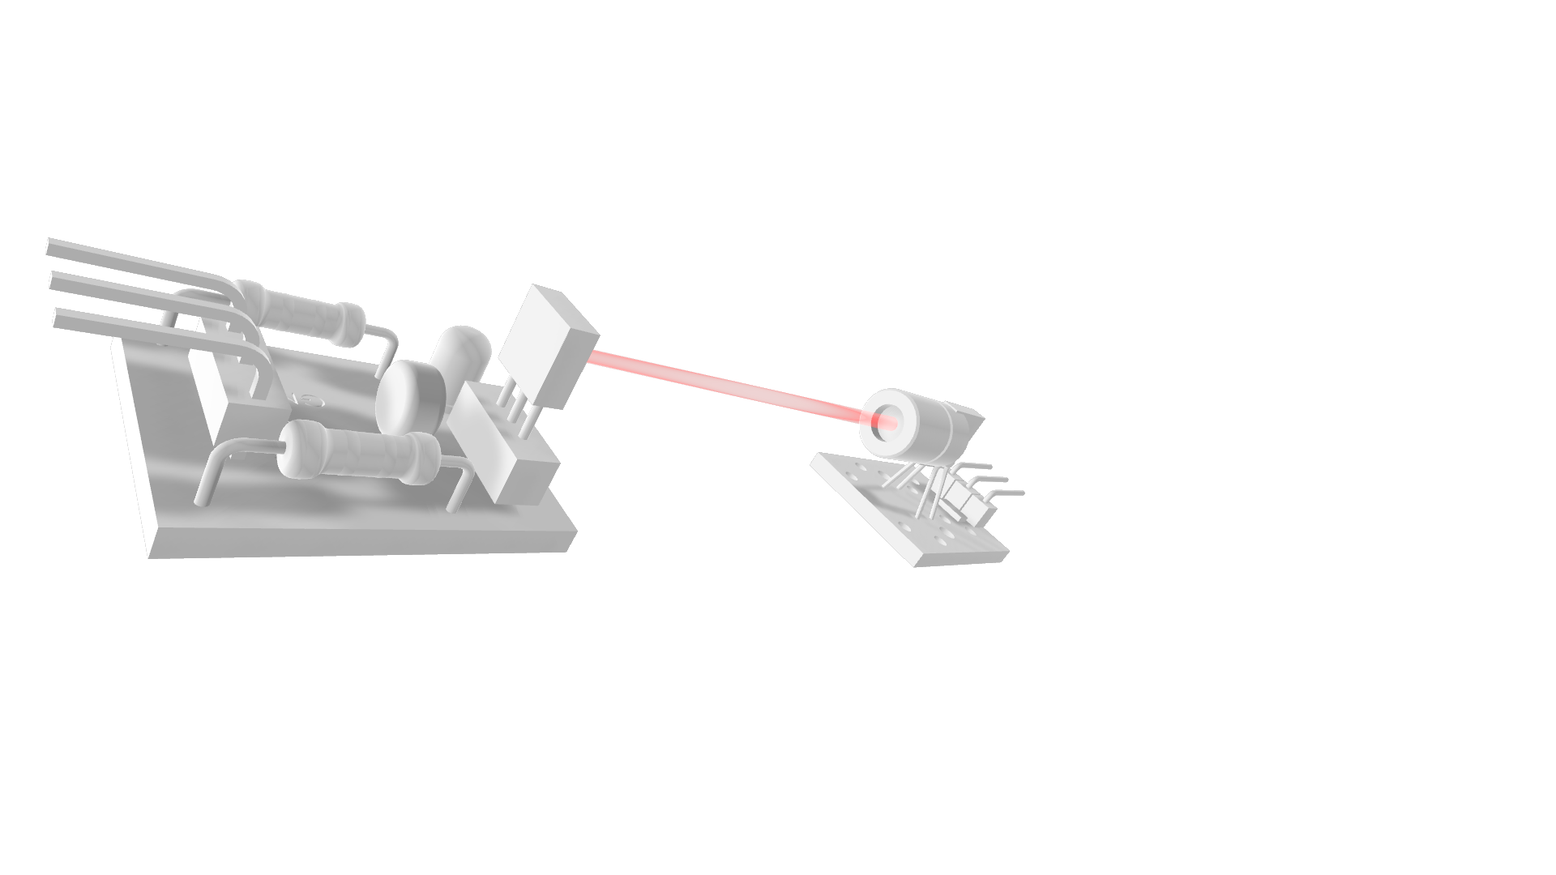
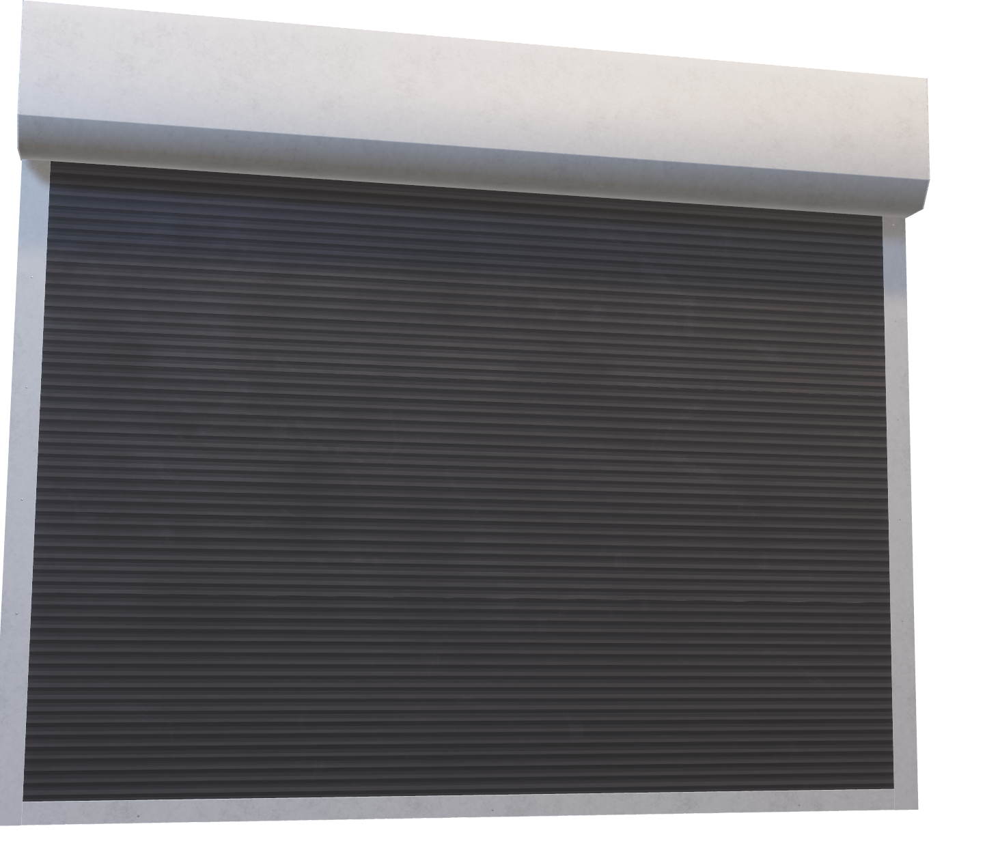
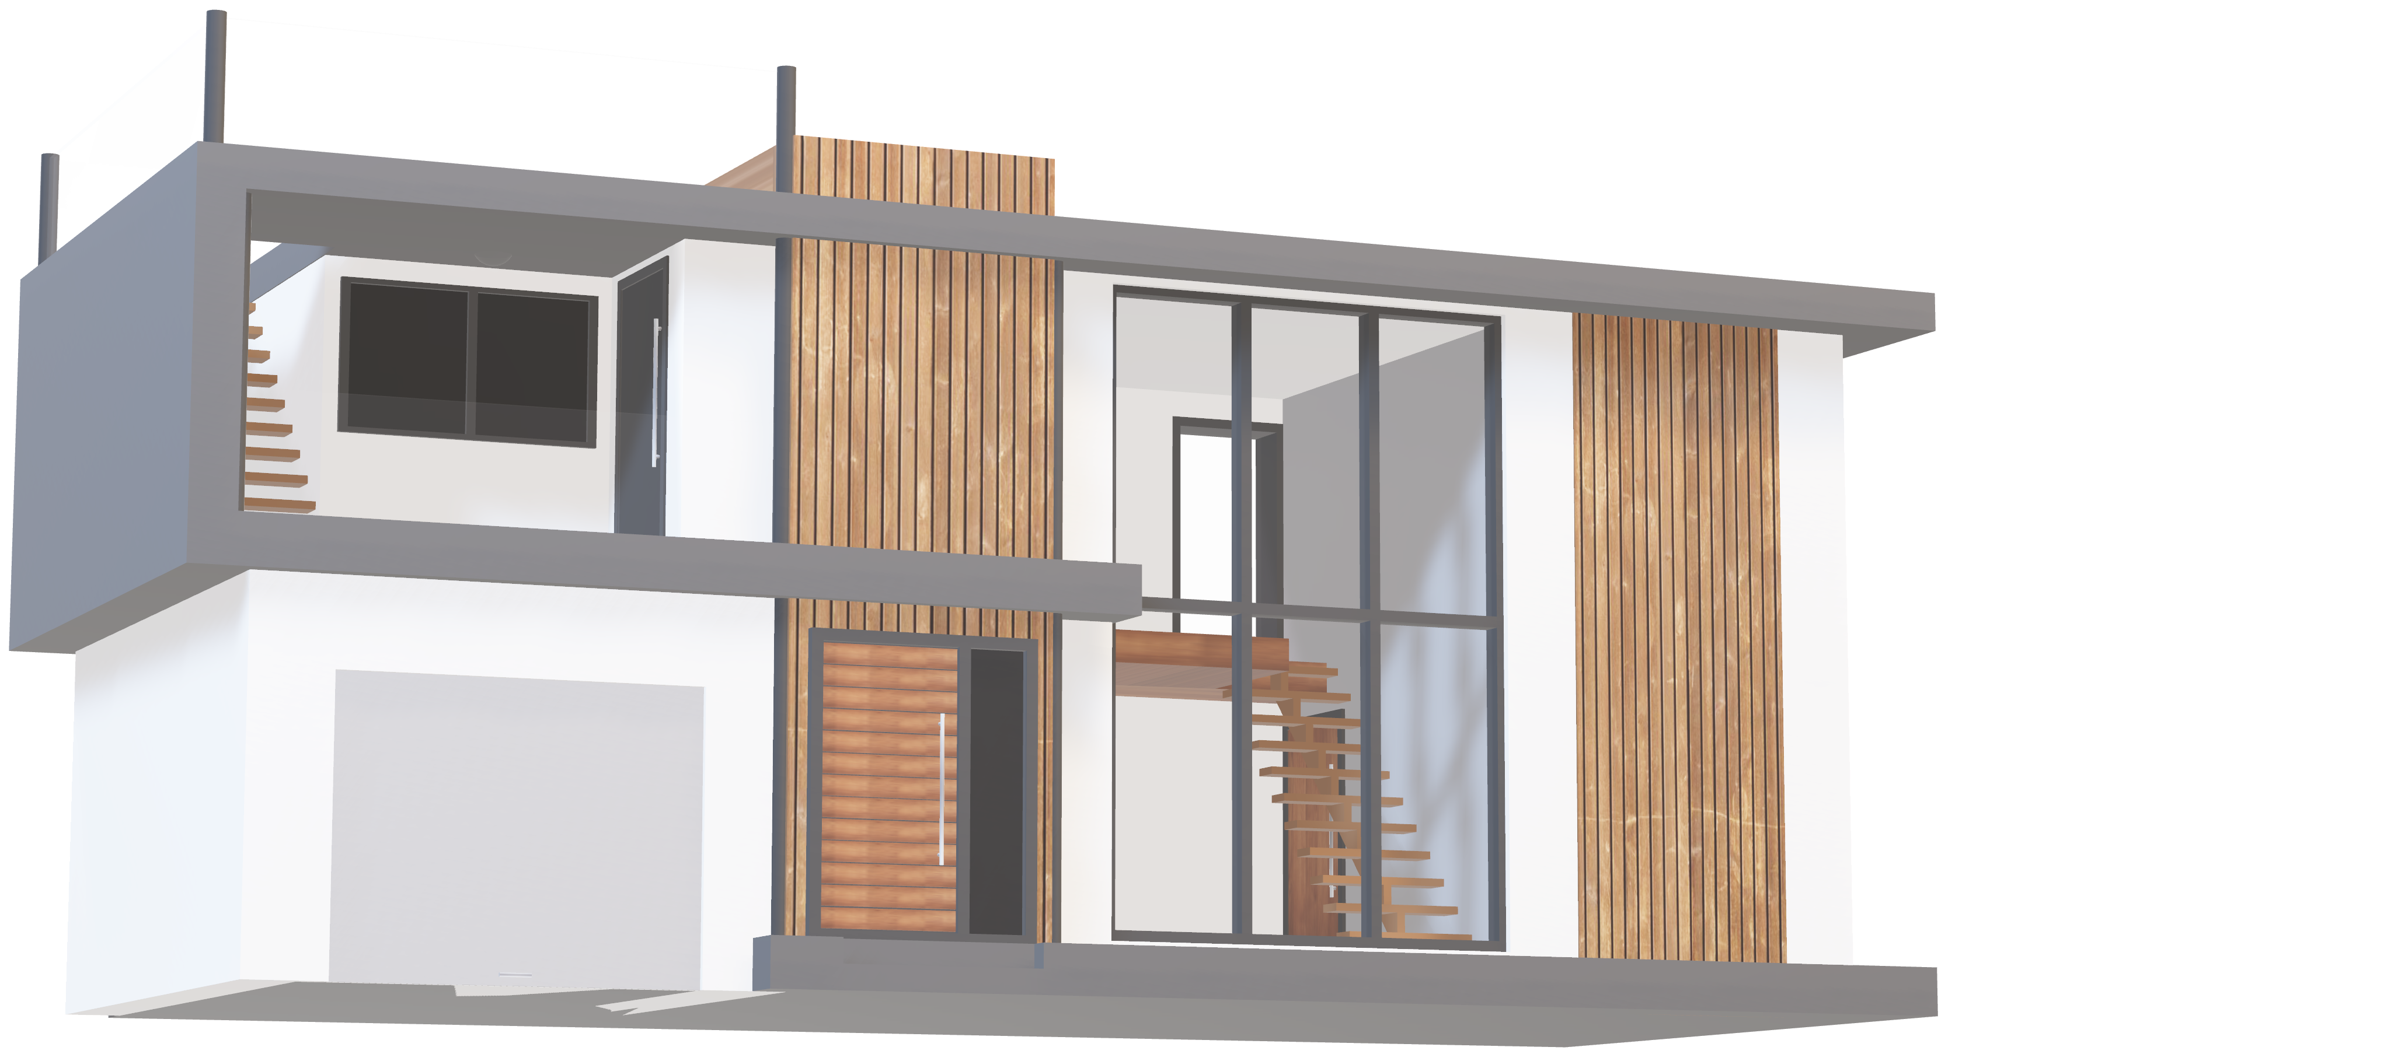
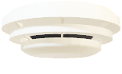
SMART HOME
Smoke sensor
Smoke detectors are essential safety equipment that identify smoke in interior spaces and act as early warning systems for possible fires.

Slide 7

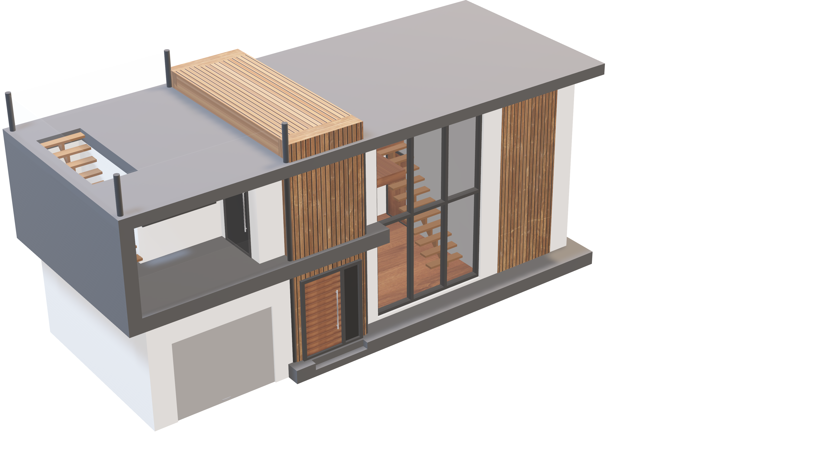
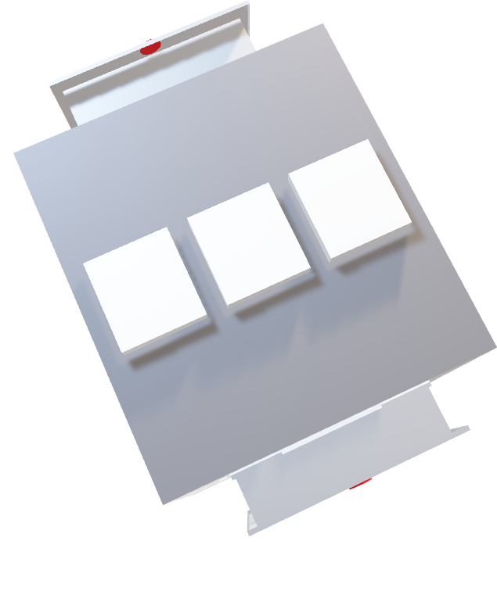
SMART HOME
Laser Security
For the safe and dependable protection of property and valuables, laser security systems are a great option. They function by directing laser beams into pre-designated locations, forming an invisible barrier.

Slide 8
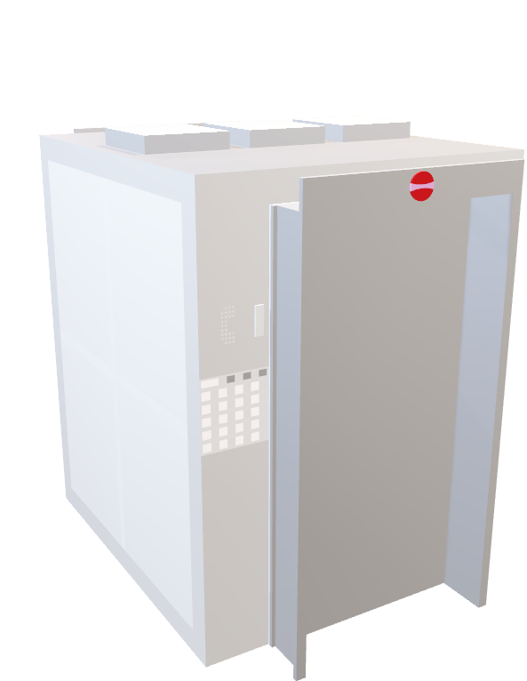
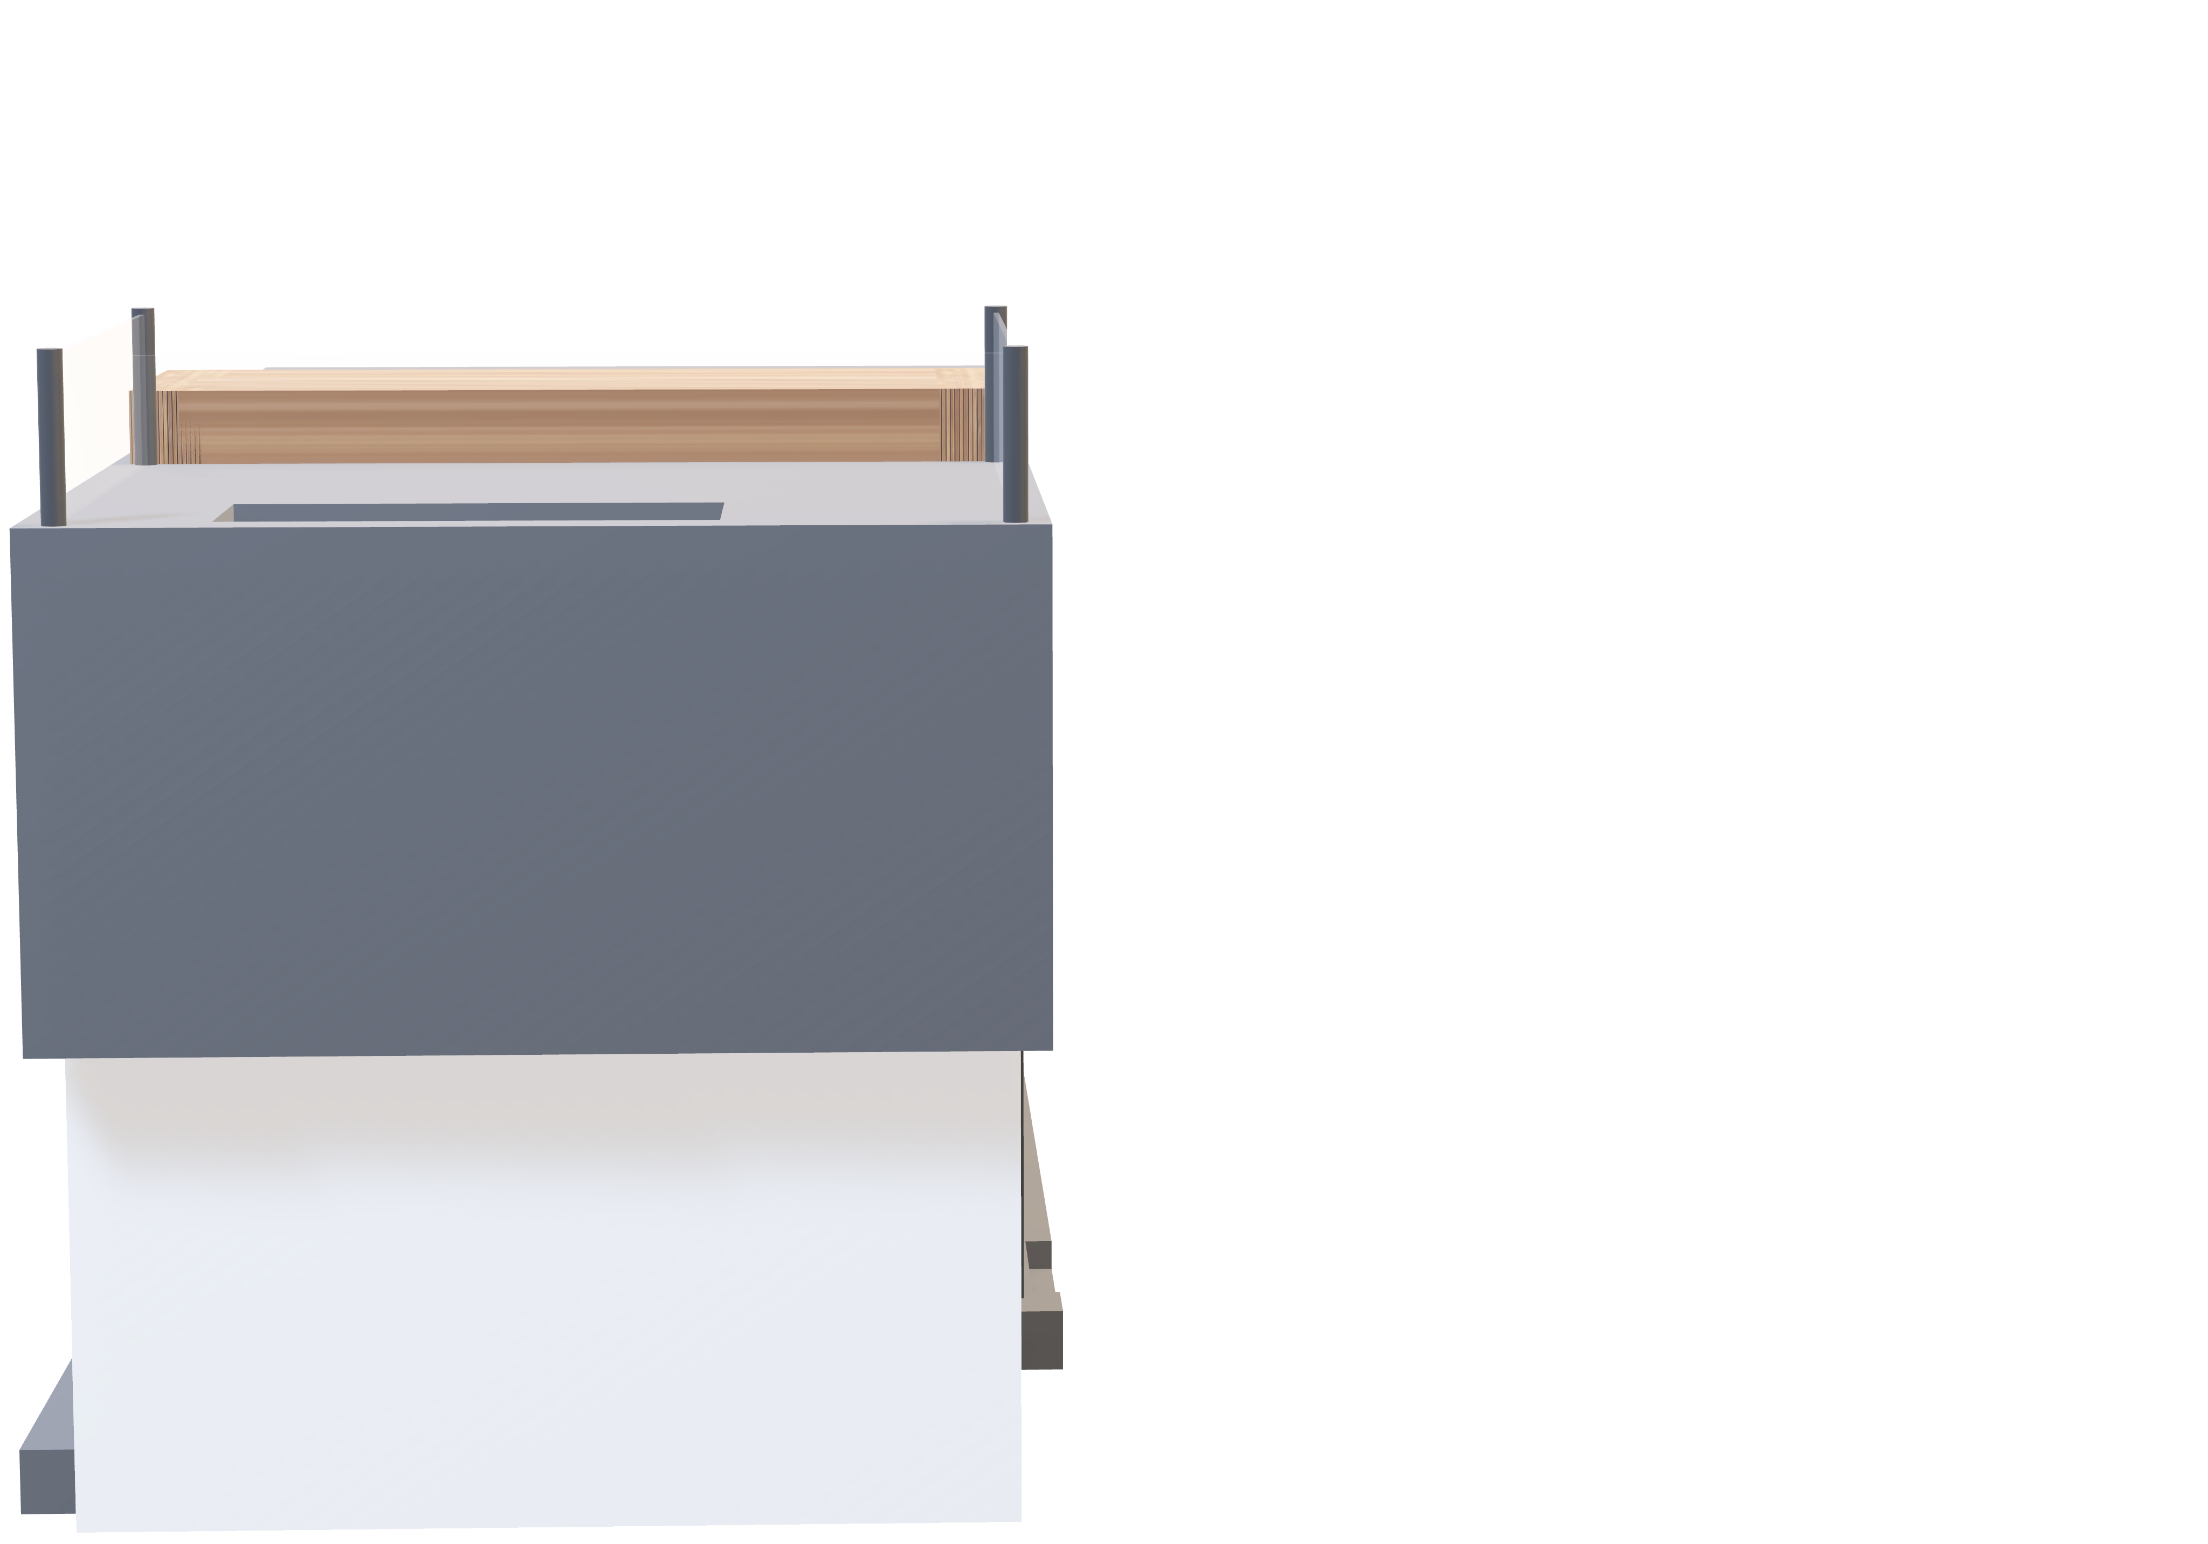
SMART HOME

Slide 9
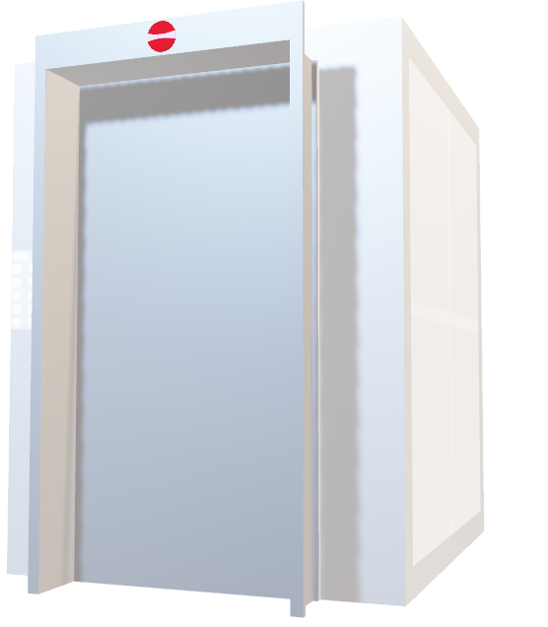
SMART HOME
Elevator
For those looking to improve accessibility and mobility in their homes, home elevators are an excellent choice.

Slide 10
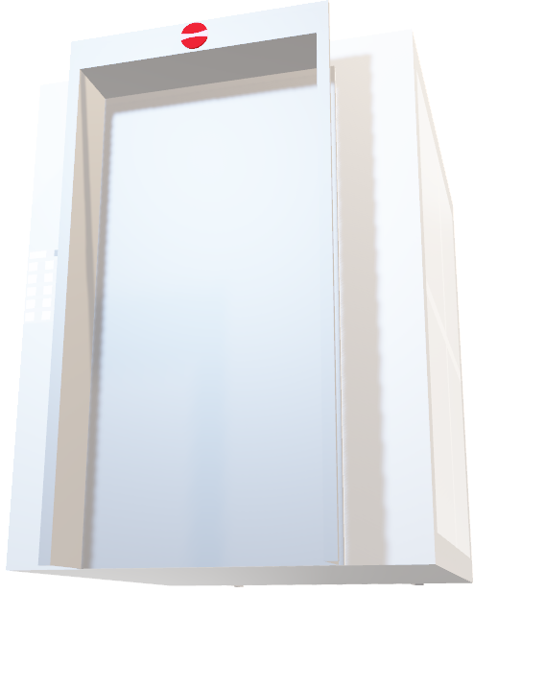
Elevator
For those looking to improve accessibility and mobility in their homes, home elevators are an excellent choice.
SMART HOME

